Slide 1
DruGen Predicting drug efficacy based on gene expression
Robin Luo – bei.luo@mail.mcgill.ca
Yuning Bie – yuning.bie@mail.mcgill.ca
Bessie Luo – bei.x.luo@mail.mcgill.ca
Team #4
PharmaHackathon – Nov 2018

Slide 2
Why do drugs work? Or not?
2 of the hardest problems in pharmacology
Sometimes drugs work, but we have no idea about its mechanism
Sometimes a drug has great binding to the target, but it doesn’t work in a cell
We can gain a lot of insight into the problem if only we could run some big data analysis on which drugs works on which kind of cells…

Slide 3
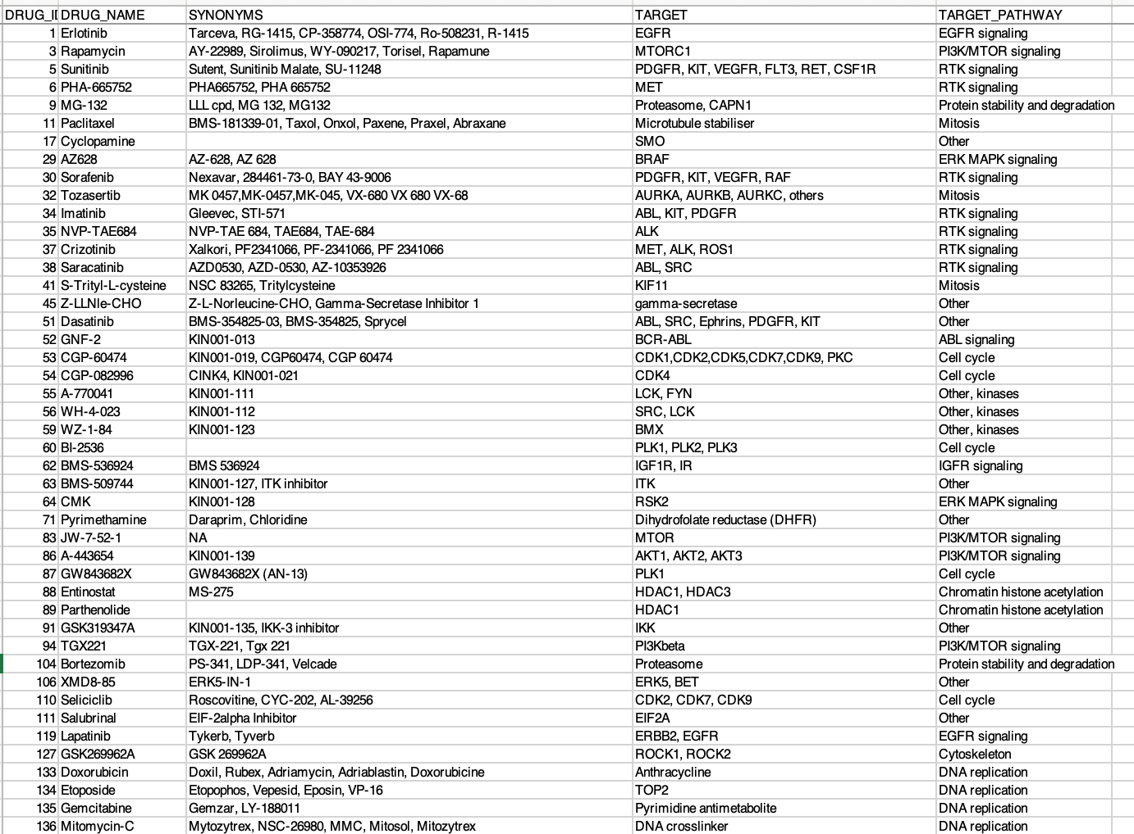
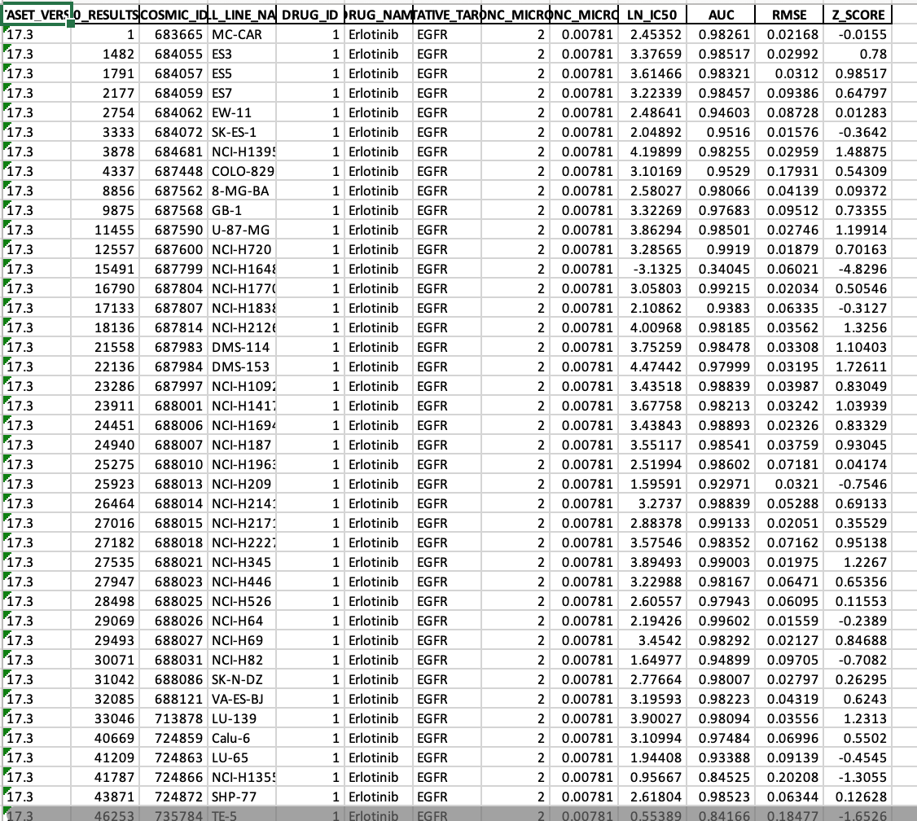
Data Time: Genomics of Drug Sensitivity in Cancer
Hundreds of drugs
Drug efficacy in hundreds of cancer cell lines
RNAseq data of all cell lines
*file too big to load into excel*

Slide 4
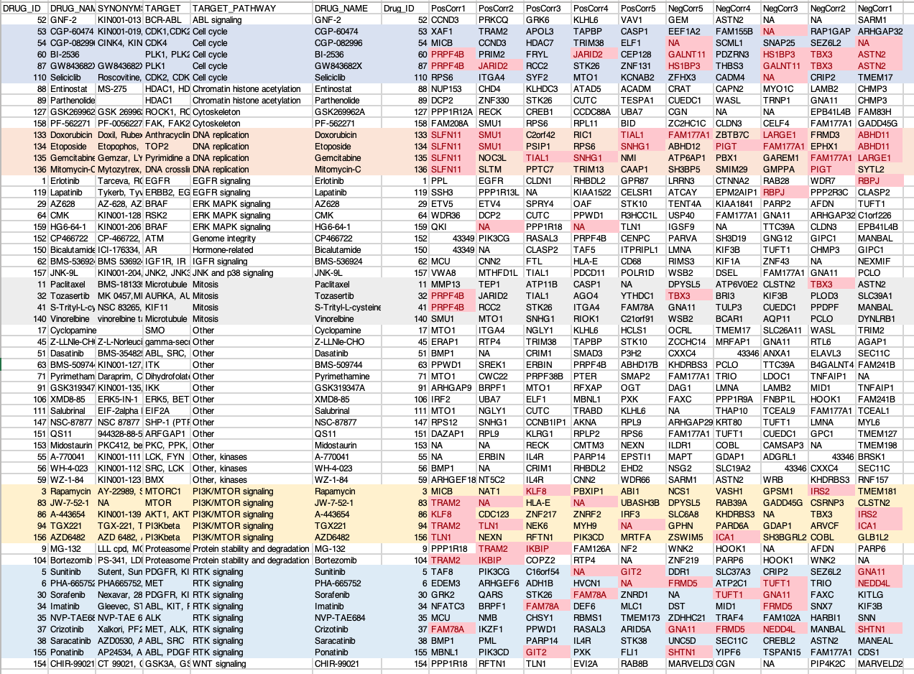
High expression
= drug effective
High expression
= drug NOT effective
Final output of DruGen

Slide 5
High expression
= drug effective
High expression
= drug NOT effective
PRPF4B is regarded as a CDK-like kinase, which is relevant to the “Cell cycle pathway” (genecards.org)

Slide 6
High expression
= drug effective
High expression
= drug NOT effective
Powerful finding! SLFN11 forces cell into apoptosis when there is DNA damage (genecards.org), which fits exactly with the drug mechanism
Furthermore, SMU1 is a regulator of DNA replication (genecards.org), which fits exactly with the drug mechanism

Slide 7
High expression
= drug effective
High expression
= drug NOT effective
Interesting, even though erlotinib targets EGFR, the expression of EGFR is not the best predictor of drug efficacy.
The best predictor of erlotinib activity is PPL, which may play a role in the AKT1/PKB pathway – this suggests PPL could be a good drug target.

Slide 8
High expression
= drug effective
High expression
= drug NOT effective
In the drugs targeting PI3K/MTOR signalling, ICA1 and IRS2 expression predicts POOR efficacy of drug. Since ICA1 and IRS2 are part of the insulin growth hormone pathway (genecards.org), the cells with high ICA1 and IRS2 can overcome PI3K/MTOR inhibition by relying on alternative signalling pathways.

Slide 9
Summary
By correlating gene expression of cancer cell lines with IC50 of anti-cancer compounds, we were able to identify the top genes whose expression that predicts either high or low drug efficacy.
We showed that in drugs that target cell cycle and DNA replication, expression of genes involved in these pathways predicts high drug efficacy
We showed that the efficacy of erlotinib (EGFR inhibitor) is well predicted by expression of EGFR, but is best predicted by PPL, which could prove to be a candidate drug target.
We showed in drugs targeting the PI3K/MTOR pathway, high expression of genes involved in the insulin signaling pathways reduces drug efficacy.

Slide 10
Conclusion
DruGen harvests the power of multiple omics datasets to generate insights into questions such as:
What is the drug’s likely mechanism of action?
What are other potential drug targets?
What genes likely cause resistance to the drug?

